Slide 1
Electrical Circuits Lecture 3: Nodal/Mesh Analysis By: Mahmoud Momtazpour ceit.aut.ac.ir/~momtazpour
Amirkabir University of Technology

Slide 2
Topic Overview
Basic Nodal and Mesh Analysis

Slide 3
Circuit Analysis
as circuits get more complicated, we need an organized method of applying KVL, KCL, and Ohm’s
nodal analysis assigns voltages to each node, and then we apply KCL
mesh analysis assigns currents to each mesh, and then we apply KVL

Slide 4
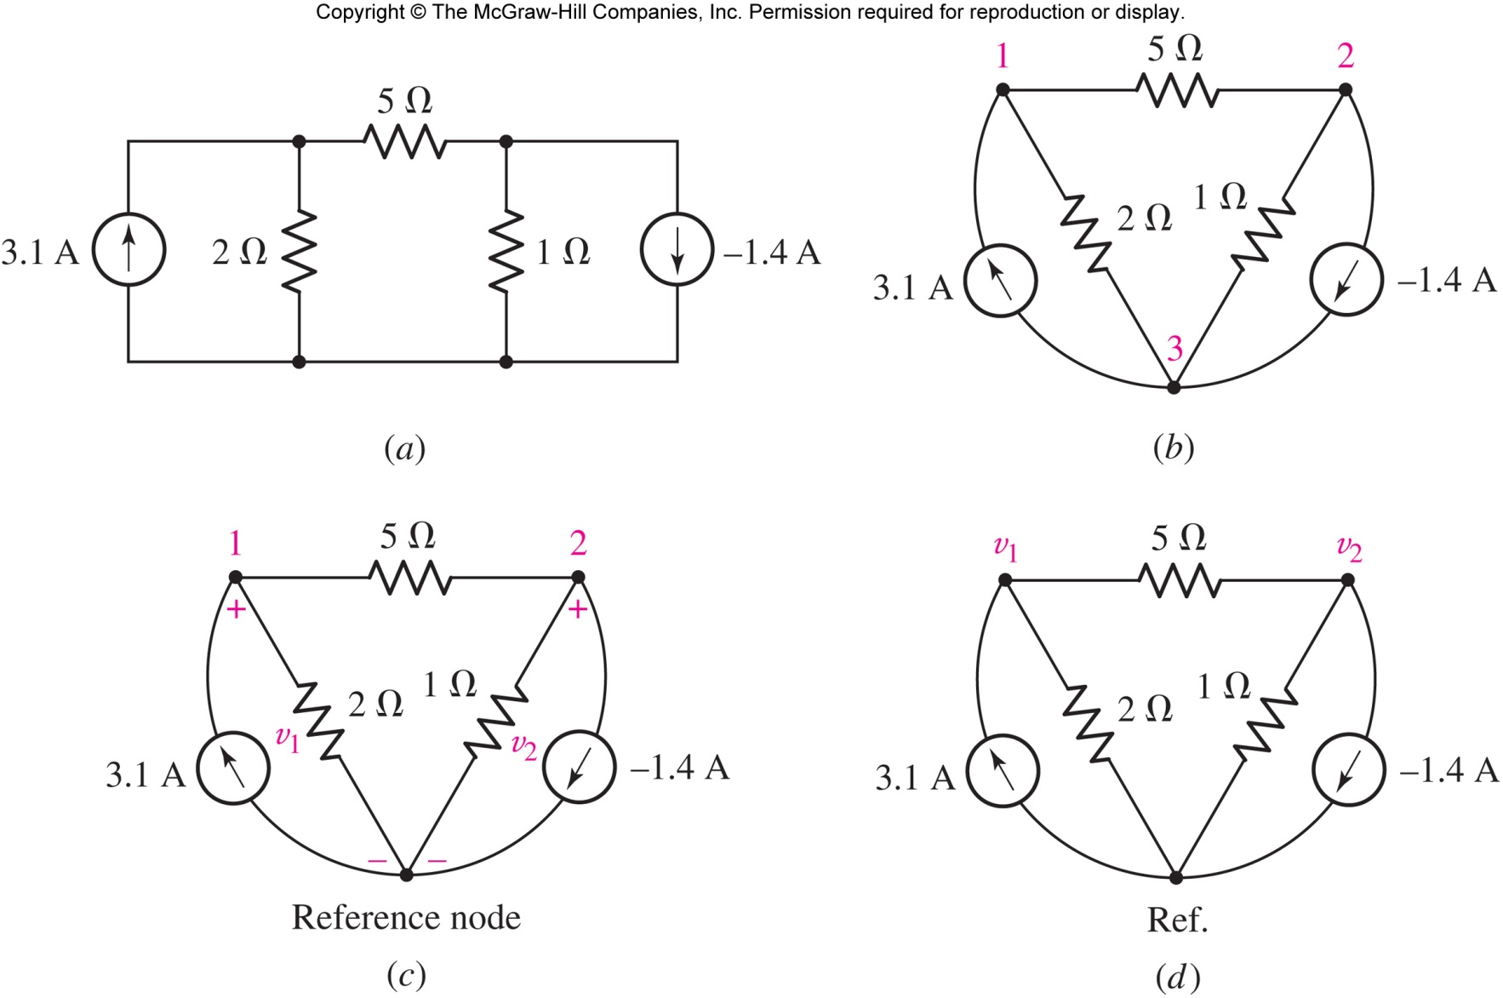
The Nodal Analysis Method
assign voltages to every node relative to a reference node
in this example, there are three nodes

Slide 5
Choosing the Reference Node
as the bottom node, or
as the ground connection, if there is one, or
a node with many connections
assign voltages relative to reference
Answer: i₃(t) = 1.333 sin t V

Slide 6
Apply KCL to Find Voltages
Apply KCL to node 1 ( Σ out = Σ in) and Ohm’s law to each resistor:

Slide 7
Apply KCL to Find Voltages
Apply KCL to node 2 ( Σ out = Σ in) and Ohm’s law to each resistor:
We now have two equations for the two unknowns v₁ and v₂ and can solve.
[ v₁ = 5 V and v₂ = 2V]

Slide 8
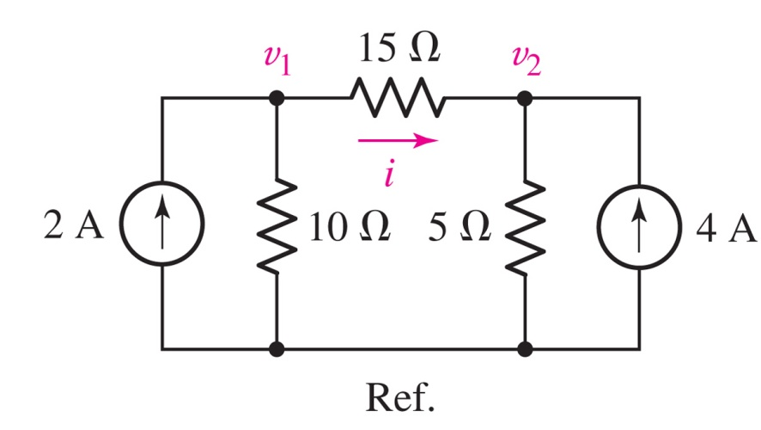
Example: Nodal Analysis
Find the current i in the circuit.
Answer: i = 0 (since v₁=v₂=20 V)

Slide 9
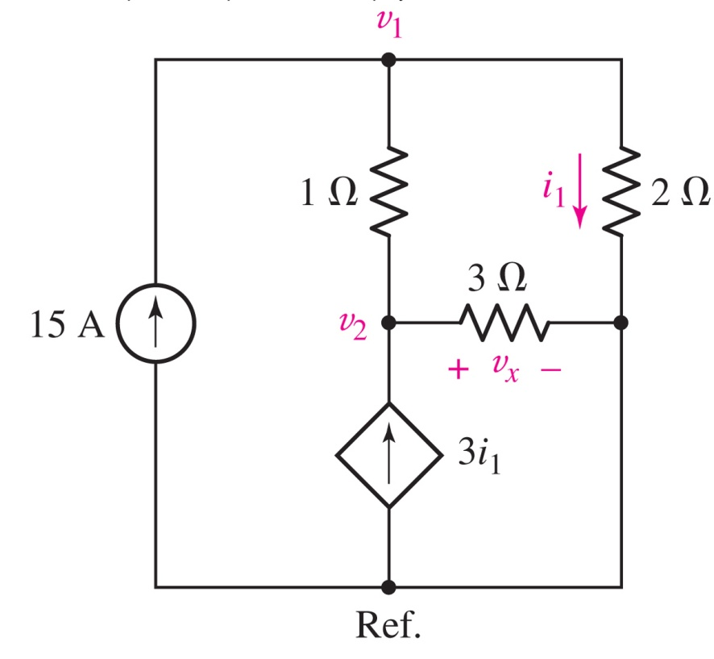
Nodal Analysis: Dependent Source Example
Determine the power supplied by the dependent source.
Key step: eliminate i₁ from the equations using v₁=2i₁
Answer: 4.5 kW

Slide 10
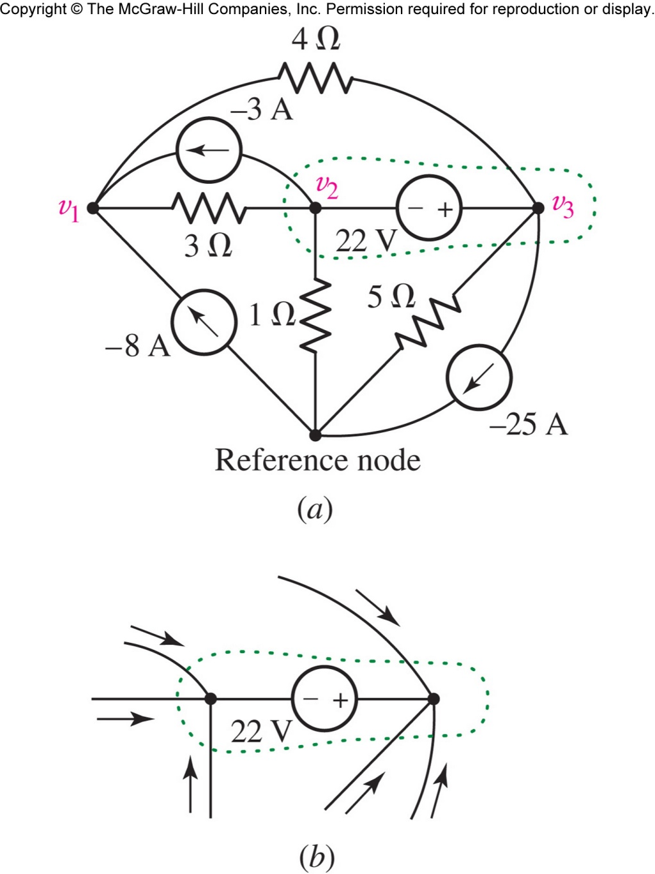
Voltage Sources and the Supernode
What is the current through a voltage source connected between nodes?
We can eliminate the need for introducing a current variable by applying KCL to the supernode.

Slide 11
The Supernode
Apply KCL at Node 1.
Apply KCL at the supernode.
Add the equation for the voltage source inside the supernode.

Slide 12
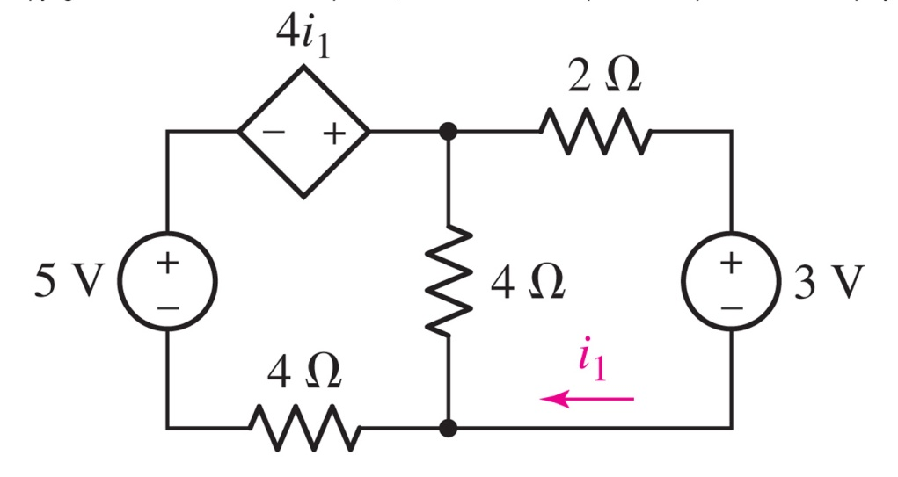

Dependent Source Example
Find i₁
Answer: i₁ = - 250 mA.

Slide 13
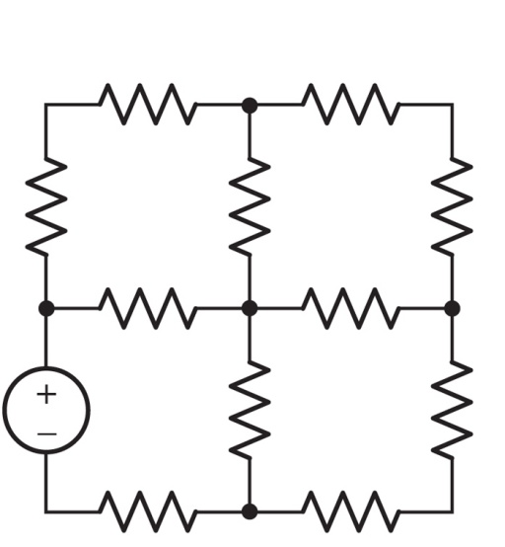
Mesh Analysis: Nodal Alternative
a mesh is a loop which does not contain any other loops within it
in mesh analysis, we assign currents and solve using KVL
assigning mesh currents automatically ensures KCL is followed
this circuit has four meshes:

Slide 14
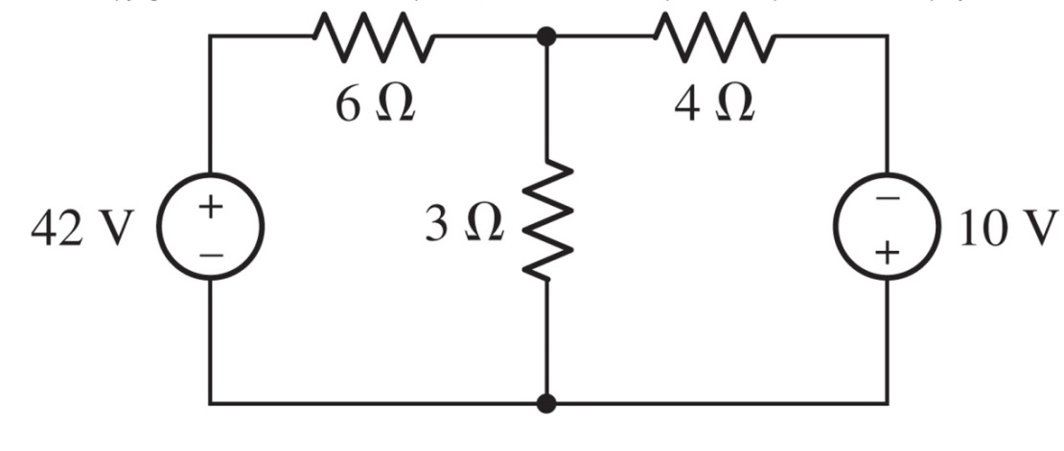
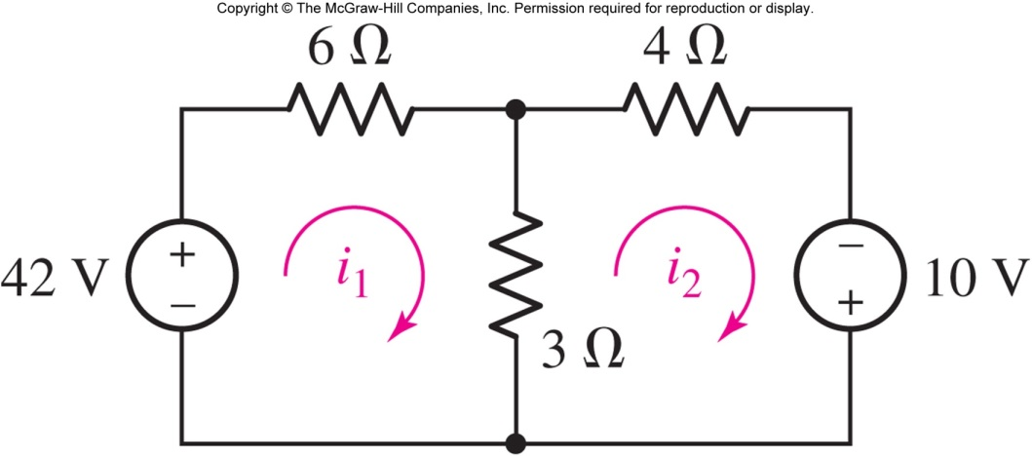

The Mesh Analysis Method
Mesh currents
Branch currents

Slide 15

Mesh: Apply KVL
Apply KVL to mesh 1
( Σ drops=0 ):
-42 + 6i₁ +3(i₁-i₂) = 0
Apply KVL to mesh 2
( Σ drops=0 ):
3(i₂-i₁) + 4i₂ -10 = 0

Slide 16
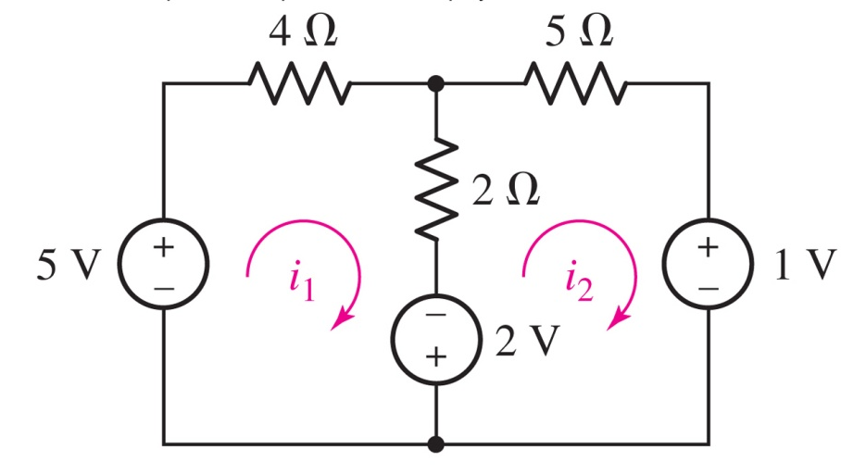
Example: Mesh Analysis
Determine the power supplied by the 2 V source.
Answer: 2.474 W
Applying KVL to the meshes:
−5 + 4i₁ + 2(i₁ − i₂) − 2 = 0
+2 + 2(i₂ − i₁) + 5i₂ + 1 = 0
Solve: i₁=1.132 A, i₂ = −0.1053 A.

Slide 17
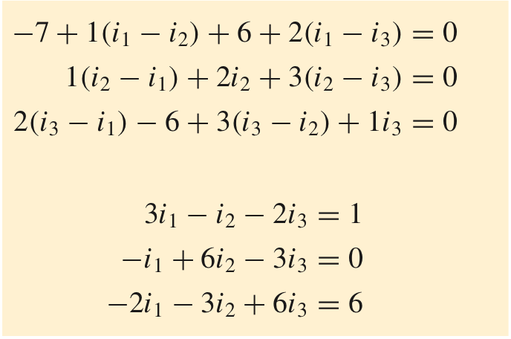
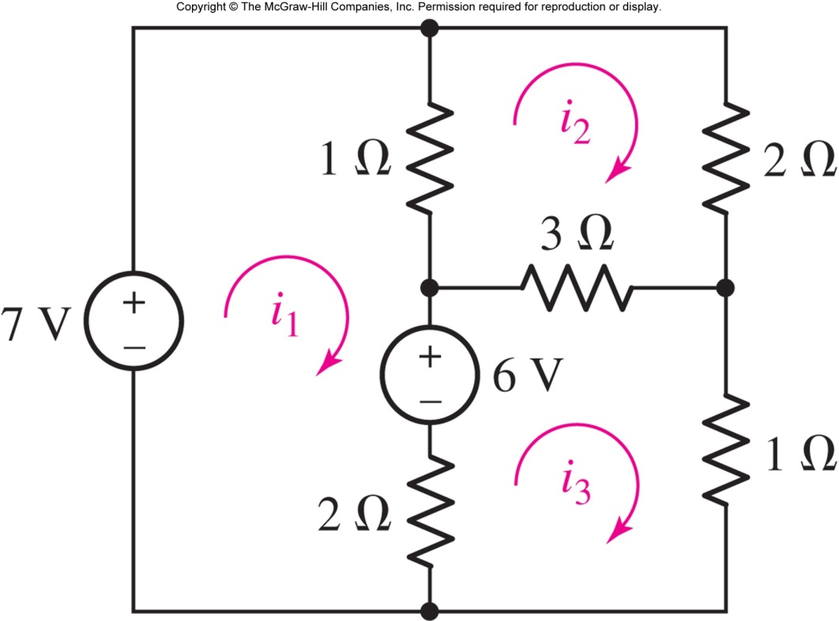
A Three Mesh Example
Follow each mesh clockwise
Simplify
Solve the equations:
i₁ = 3 A, i₂ = 2 A, and i₃ = 3 A.

Slide 18
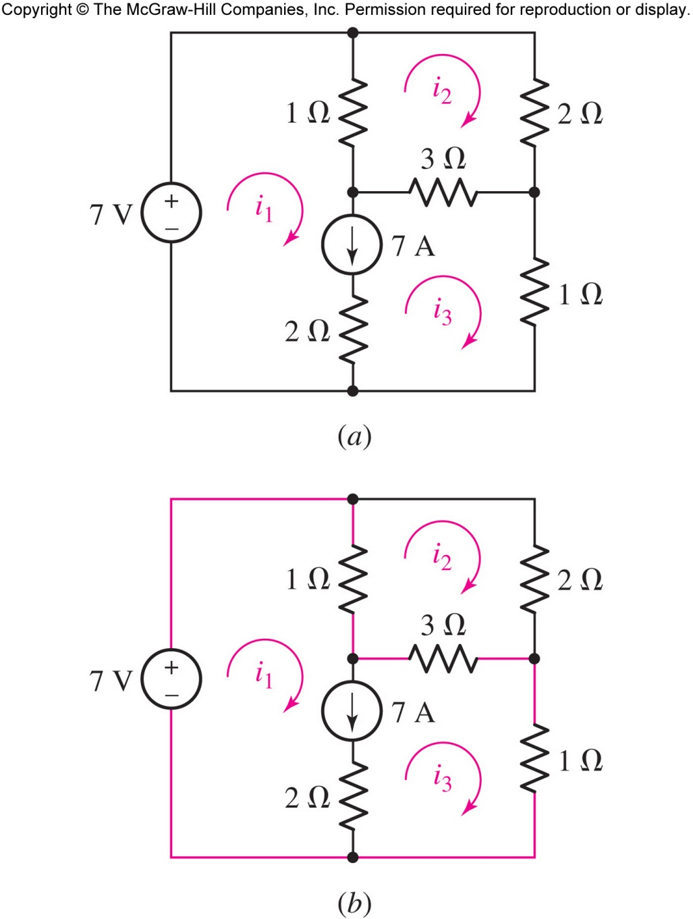
Current Sources and the Supermesh
What is the voltage across a current source in between two meshes?
We can eliminate the need for introducing a voltage variable by applying KVL to the supermesh formed by joining mesh 1 and mesh 3.

Slide 19
The Supermesh
Apply KVL to mesh 2:
1(i₂ − i₁) + 2i₂ + 3(i₂ − i₃) = 0
Apply KVL supermesh 1/3:
-7 +1(i₁ − i₂) + 3(i₃ − i₂) +1i₃ = 0
Add the current source:
7 =i₁ − i₃

Slide 20
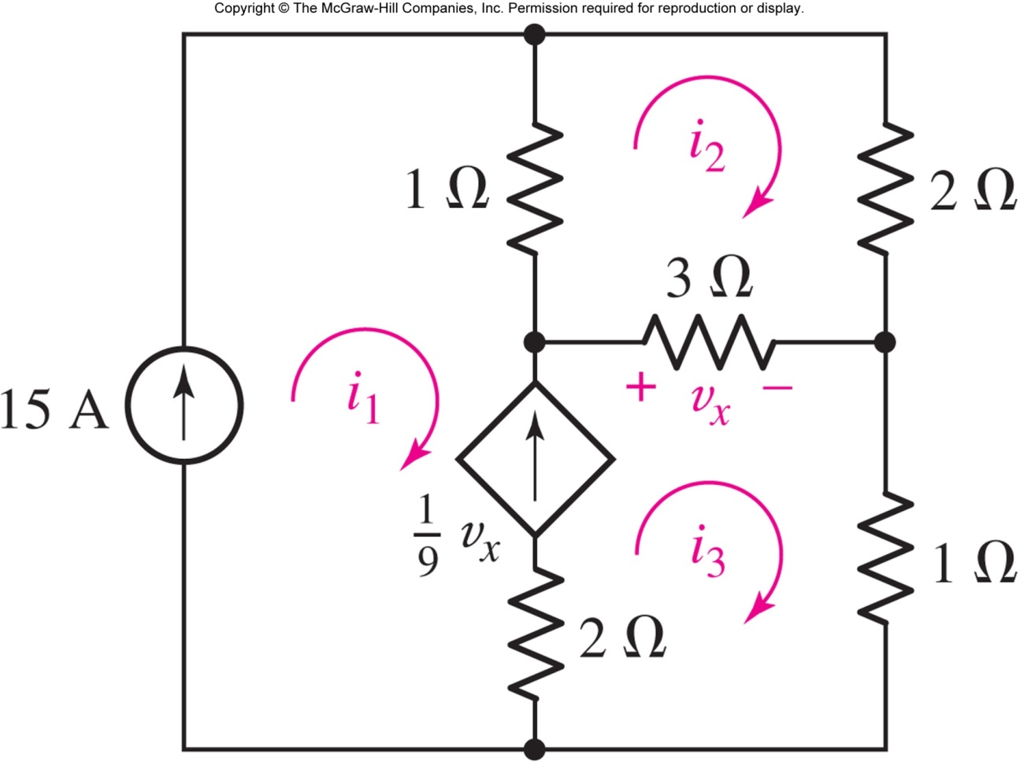
Dependent Source Example
Find the currents.
Key step:
Answer: i₁ = 15 A , i₂ = 11 A, and i₃ = 17 A

Slide 21
Node or Mesh: How to Choose?
use the one with fewer equations, or
use the method you like best, or
use both (as a check), or
use circuit simplifying methods from the next chapter

Slide 22
Summary
Nodal Analysis
Find all the nodes, set one of them as the reference node (with V_{ref}=0), and assign the other nodes proper names (e.g. V1, V2, …)
Short circuit all voltage sources (dependent or independent)
Write KCL for the remaining nodes
Write equations for voltage sources (if necessary)
Write equations for dependent sources based on node voltages (if necessary)

Slide 23
Summary (Con’t)
Mesh Analysis
Find all the meshes, and assign them proper names (e.g. i1, i2, …)
Open circuit all current sources (dependent or independent)
Write KVL for the remaining meshes
Write equations for current sources (if necessary)
Write equations for dependent sources based on mesh currents (if necessary)

Slide 24
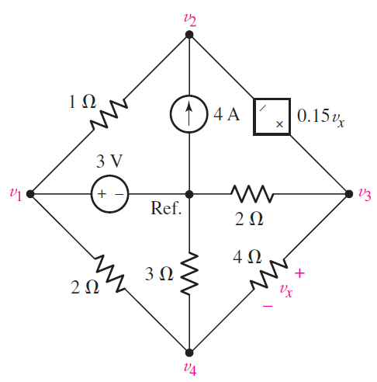
In-class Exercise
Find v_{x} with Nodal analysis method?
Find all nodes
Short circuit
voltage sources
Write KCL
Write Eq. for
voltage sources
Write Eq. for
dependent Sources

Slide 25
In-class Exercise 2
Find v_{x} with Mesh analysis method?
Find all meshes
Open circuit
current sources
Write KVL
Write Eq. for
current sources
Write Eq. for
dependent Sources

